Slide 1
Design of Free-Ride Linear Block Codes: Puncturing Pattern Optimization and Graph Structure
GiGi Chou
Advisor: Prof. Jiun Hung Yu
Prof. Tofar Chih-Yuan Chang
Transmission and Networking Technologies Laboratory,
Institute of Communications Engineering
National Chiao Tung University, Hsinchu, Taiwan

Slide 2
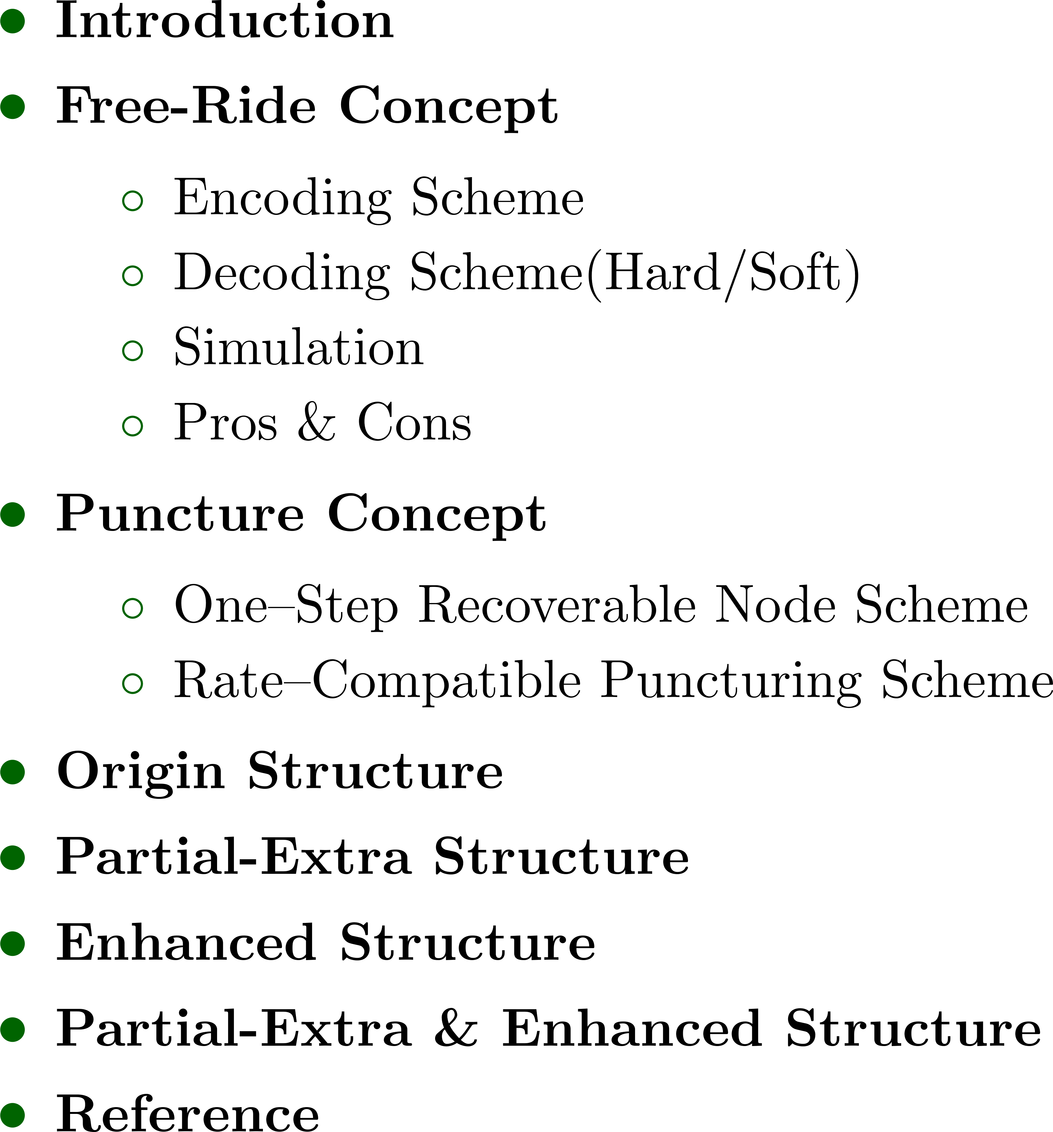
Outline

Slide 3
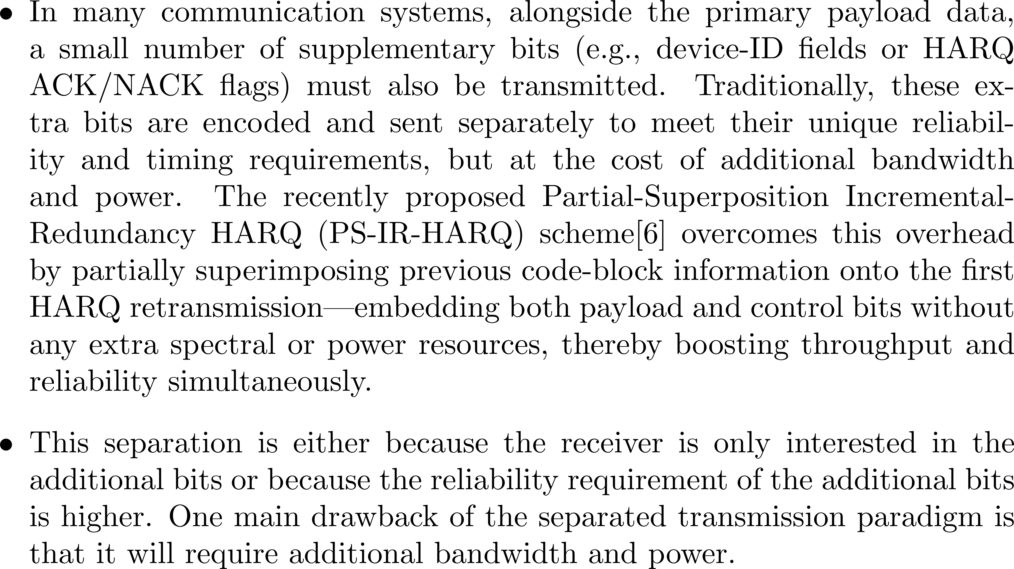
Introduction
Notes:
在許多通訊系統中，除了主要的載荷資料之外，還需要傳送少量的補充位元（例如裝置識別欄位或 HARQ 的 ACK/NACK 標誌）。傳統上，這些額外位元會與載荷資料分開編碼並獨立傳輸，以滿足它們對可靠度與時序的特殊需求，卻也因此帶來額外的頻寬與功率開銷。最近提出的**部分超疊加增量冗餘 HARQ（PS-IR-HARQ）**方案，透過在第一次 HARQ 重傳時，將先前的碼塊資訊部分超疊加到新重傳資料中，實現載荷位元與控制位元的同時承載，且不增加任何頻譜或功率資源，從而同時提升系統吞吐量與可靠度。

Slide 4
Outline

Slide 5
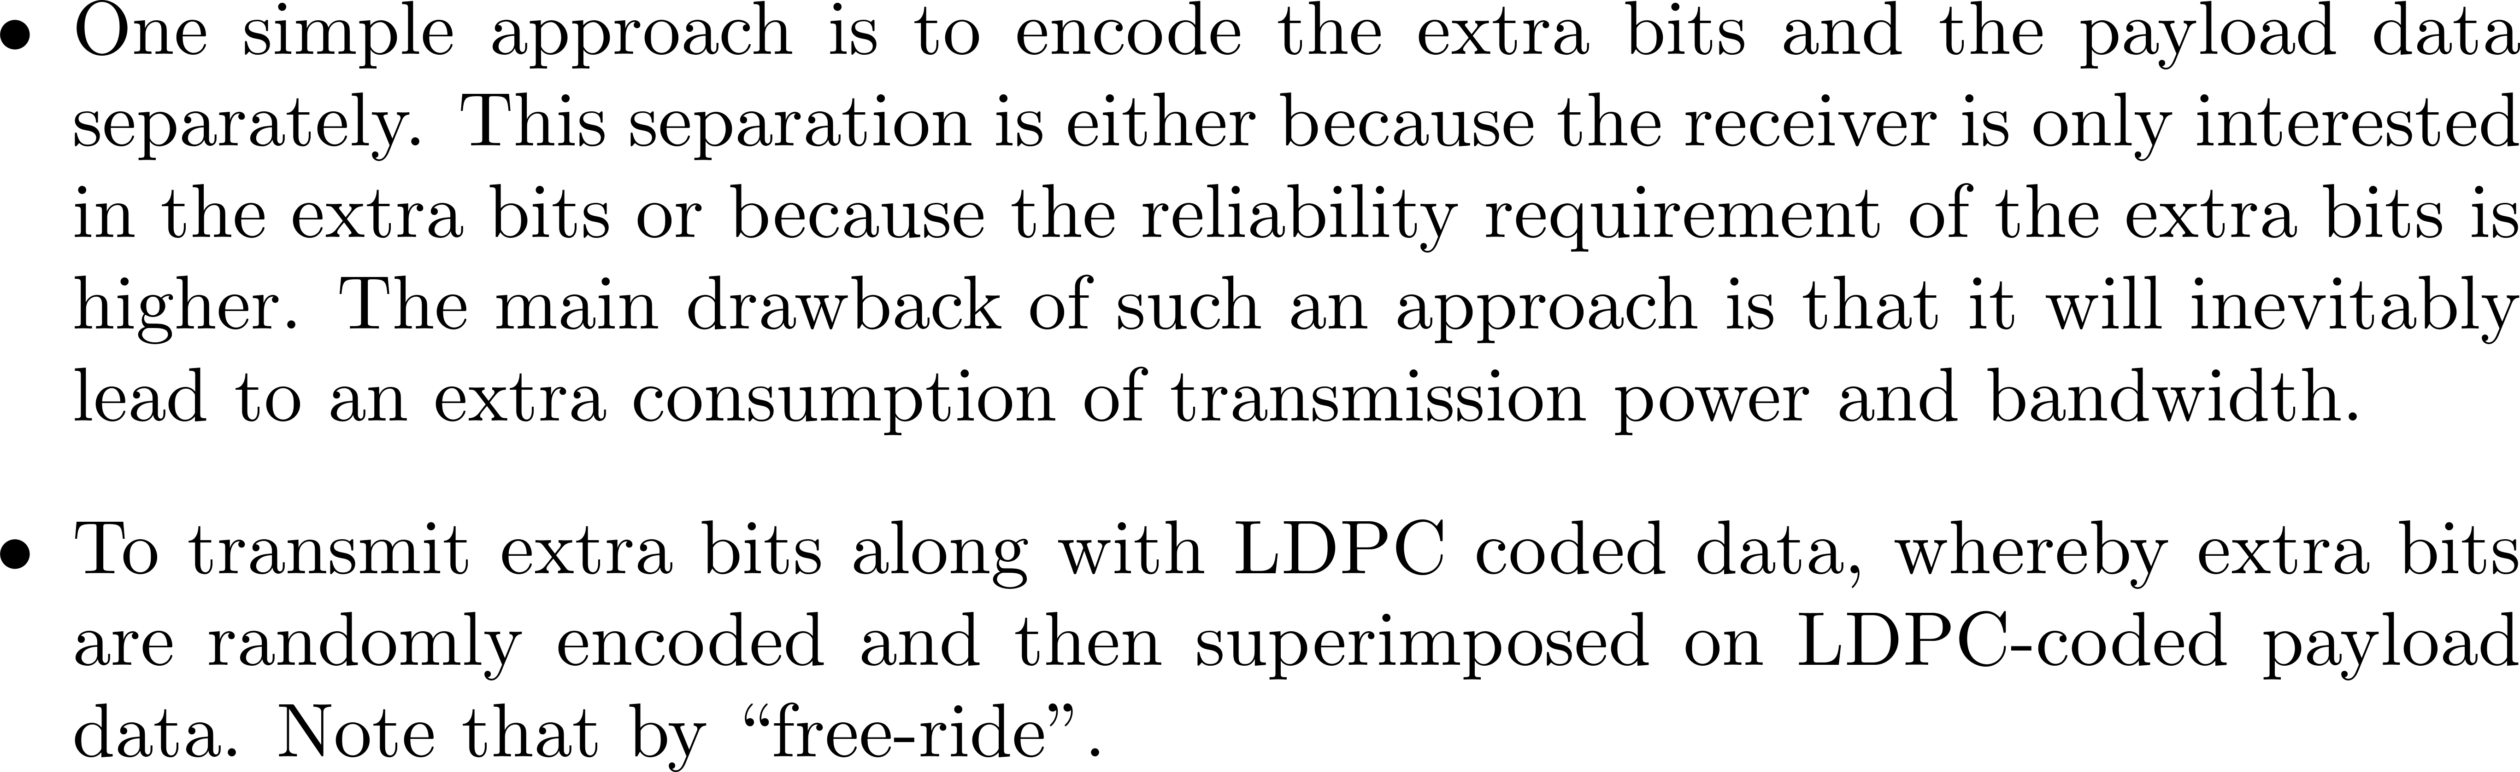
Free-Ride Concept

Slide 6
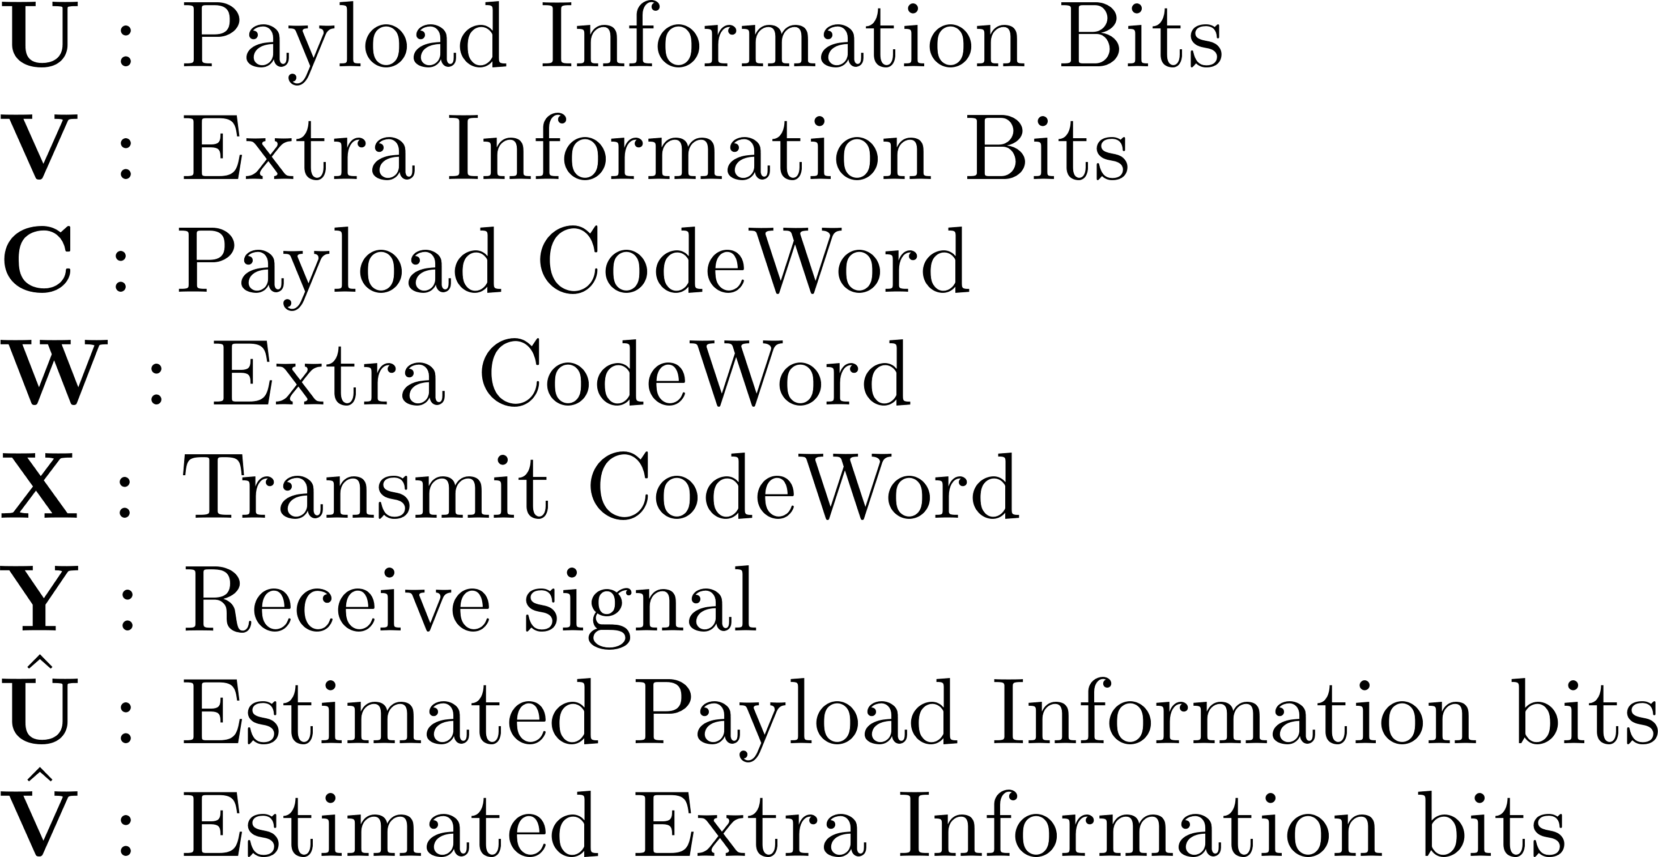
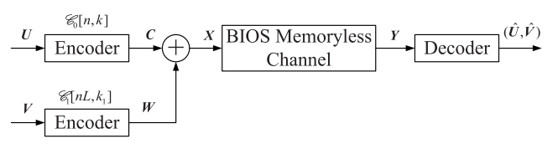


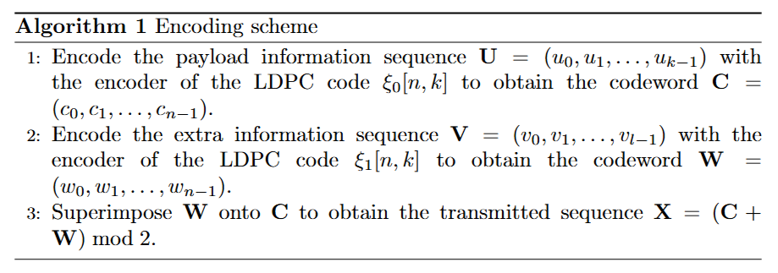

Free-Ride – Encoding Concept

Slide 7
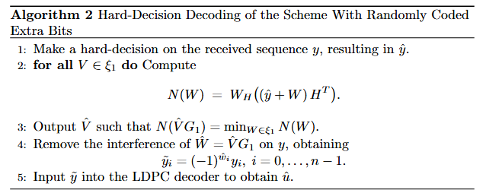
Free-Ride – Hard Decoding

Slide 8
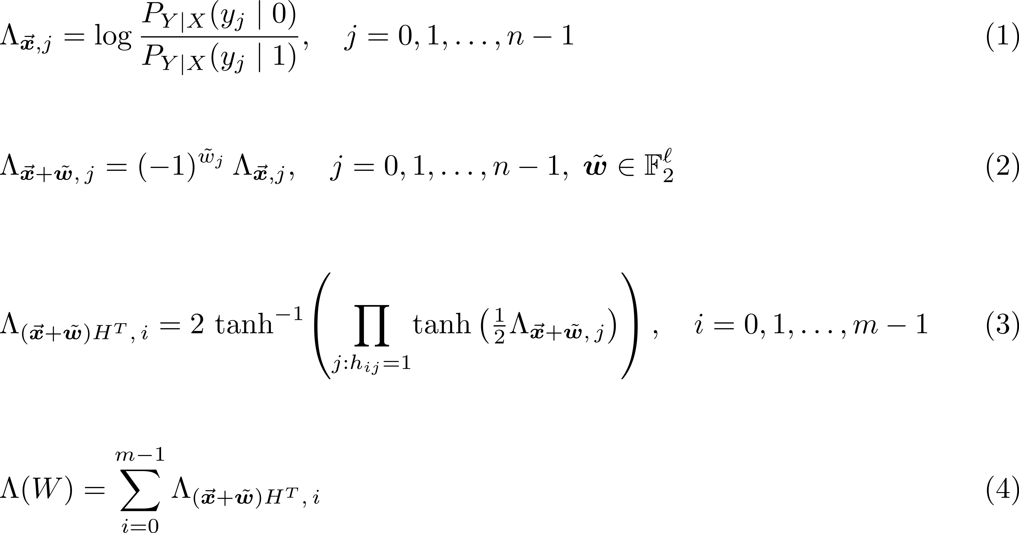
Free-Ride – Soft Decoding

Slide 9
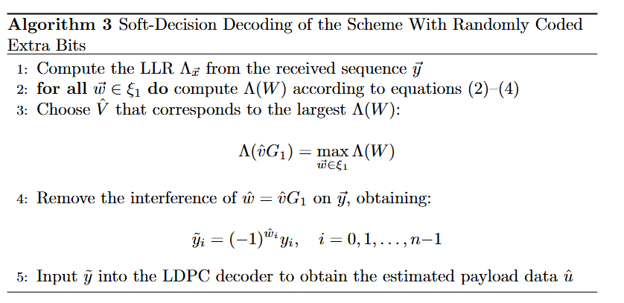
Free-Ride – Soft Decoding

Slide 10
Free-Ride – Code Information
Code | Codeword Length | Information Length | Code Rate | Max Col Degree | Max Row Degree | Girth
PEG-P1 | 1008 | 504 | 0.5 | 3 | 8 | 8
LDPC-E1 | 10 | 5 | 0.5 | 2 | 4 | 6
LDPC-E2 | 96 | 48 | 0.5 | 3 | 6 | 6
BCH-E3 | 15 | 7 | 0.47 | 4 | 4 | 6

Slide 11
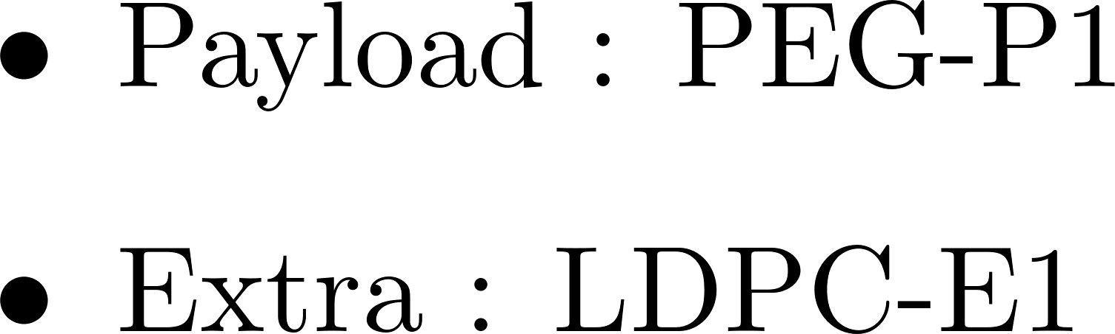
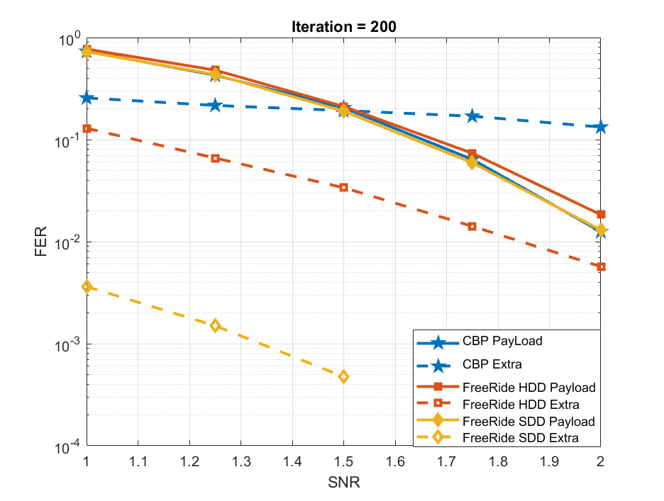
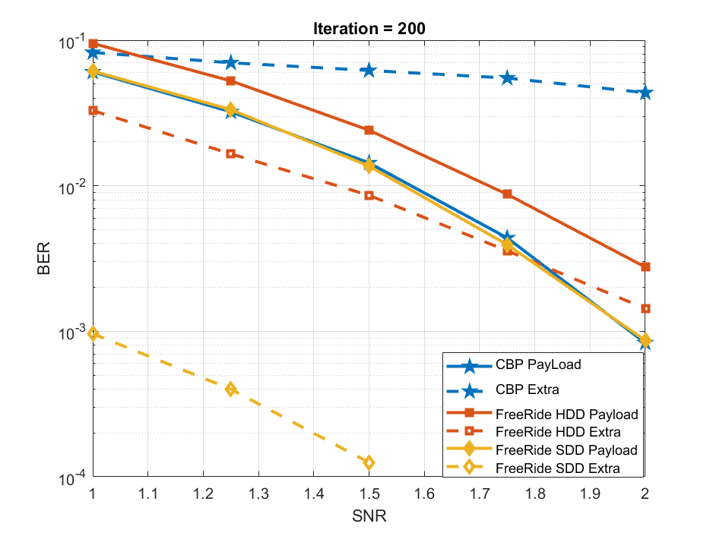
Free-Ride – Simulation

Slide 12
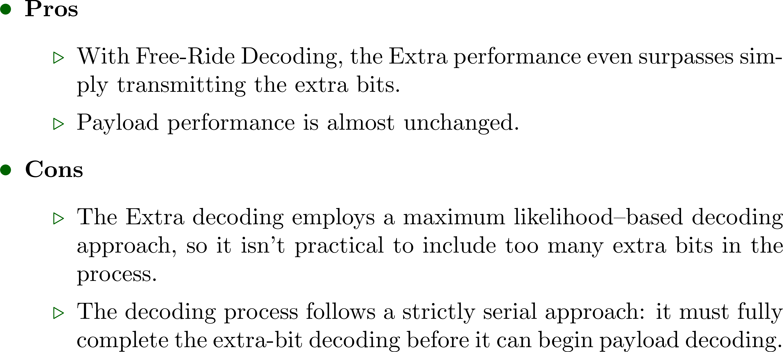
Free-Ride – Pros & Cons

Slide 13
Outline

Slide 14
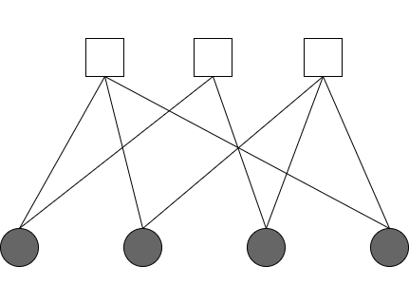
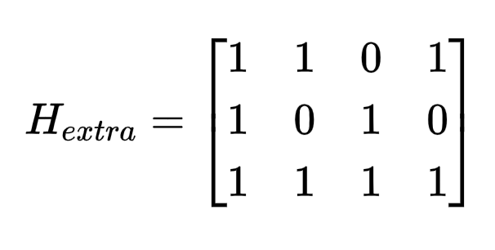

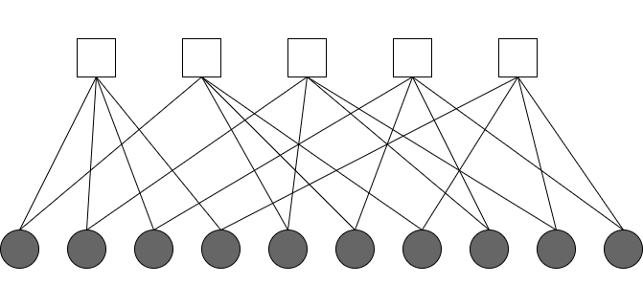
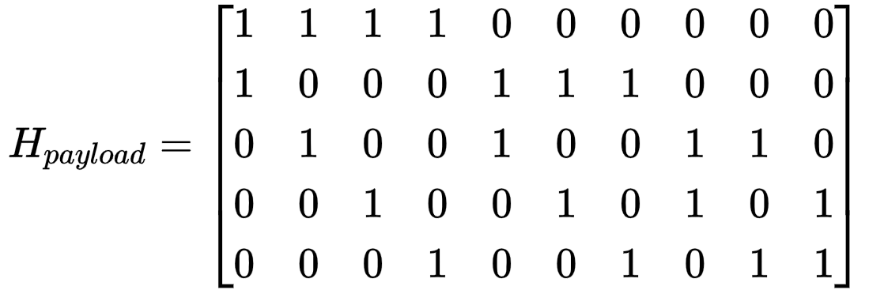
Tanner Graph Combination

Slide 15
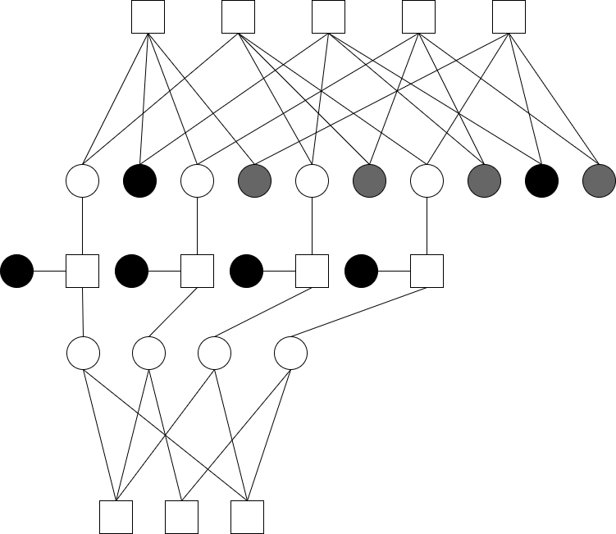
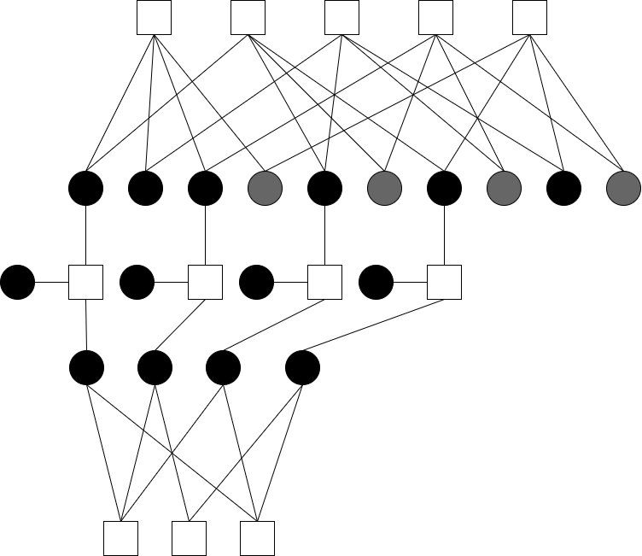
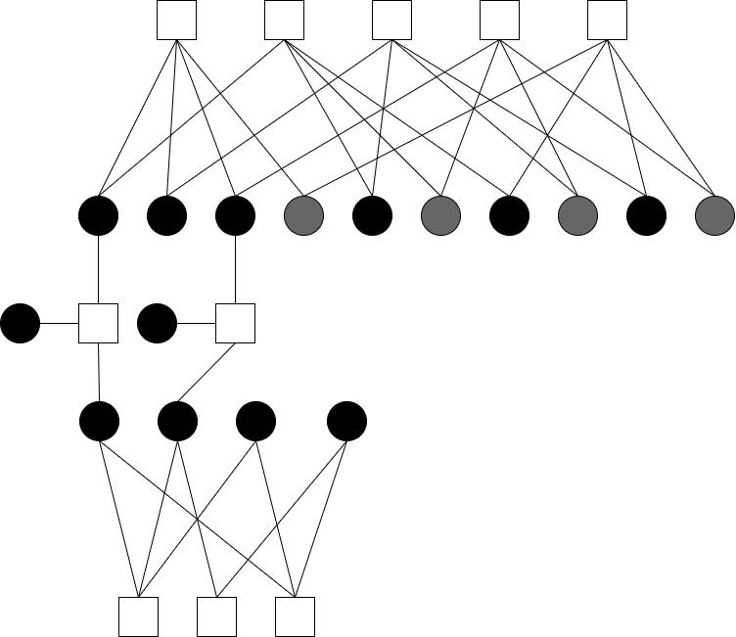
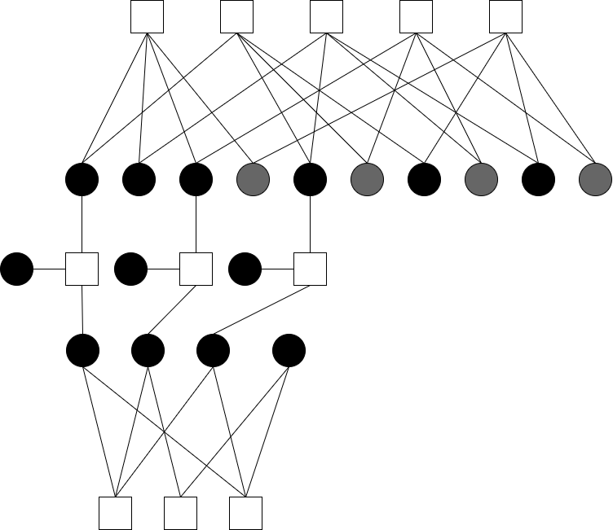
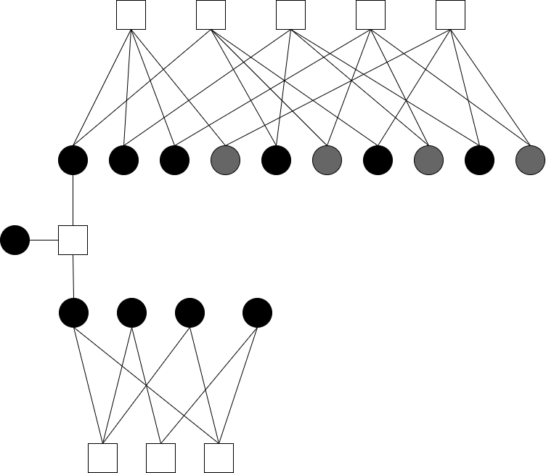
Tanner Graph Combination
A
(A^B)^A^B
A^B
B

Slide 16
Outline

Slide 17
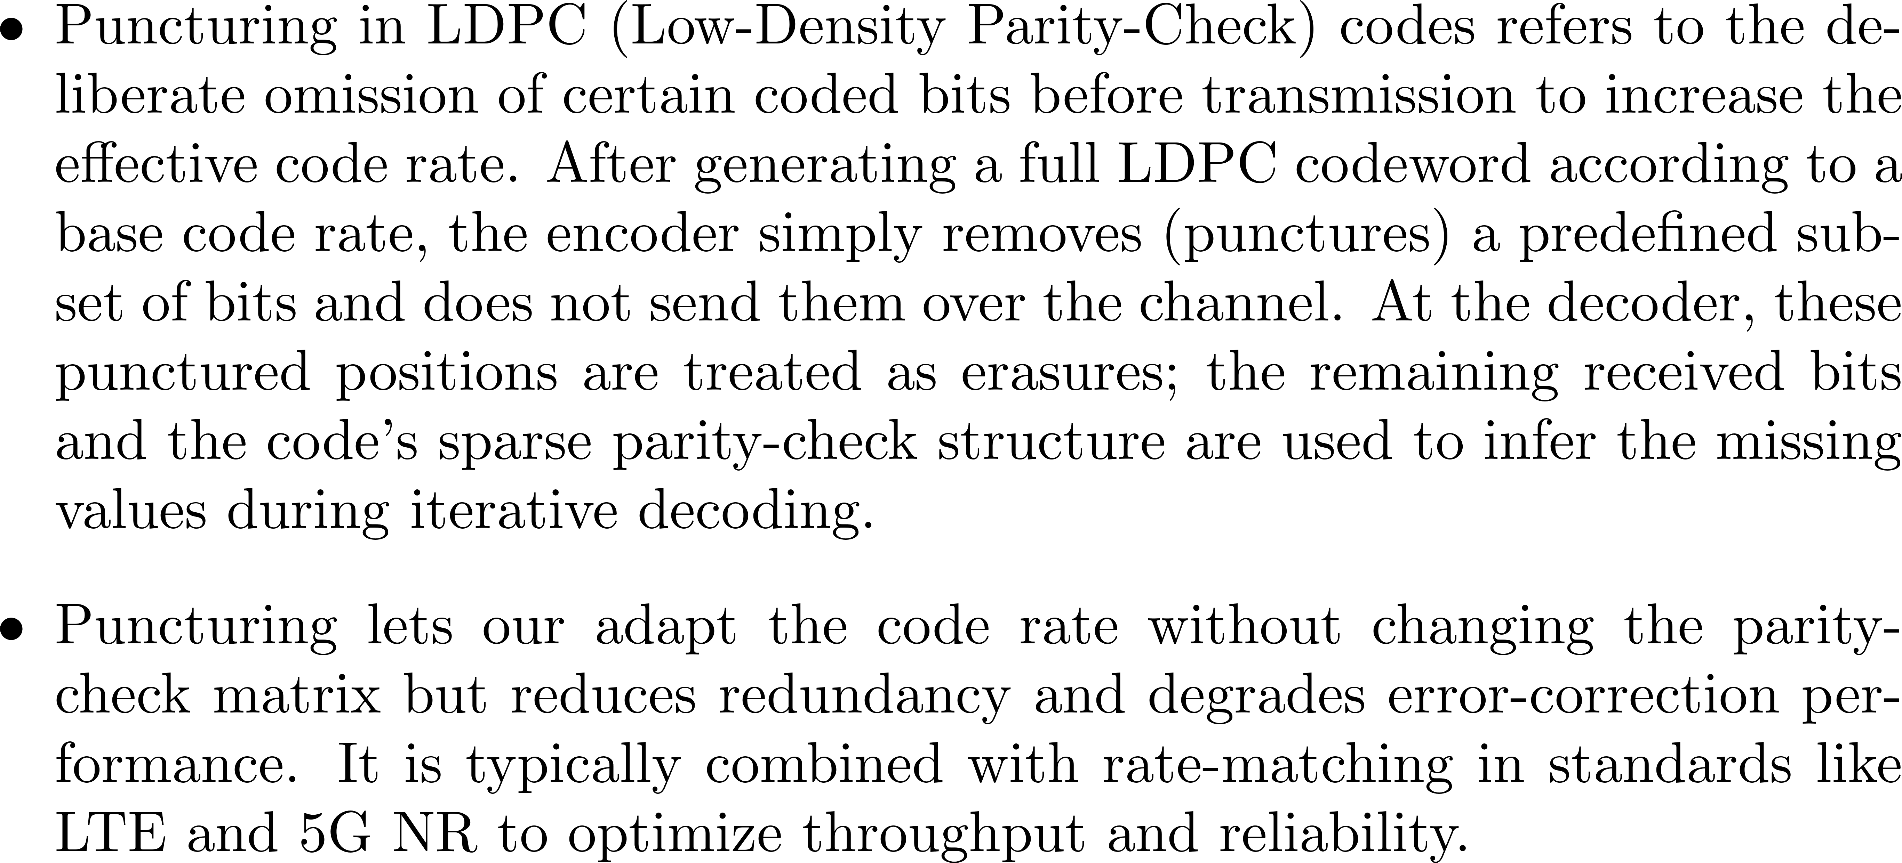
Puncture – Concept
Notes:
LDPC（低密度奇偶校验码）打孔（puncturing）是一种通过“删减”部分编码比特位来提高有效码率的技术。在编码器端，首先按照原始码率生成完整的 LDPC 码字，然后有选择地将若干比特位置标记为“打孔”，不将其通过信道发送。接收端接收到的序列中，这些打孔位置被视作“未知”或“擦除”，在译码时利用剩余的校验关系和对称信道假设来恢复它们的值。
打孔可在不變更校驗矩陣的情況下調整碼率，但會減少冗餘度並削弱糾錯性能。實務中常與速率匹配技術（如 LTE、5G NR）結合，以平衡吞吐量與可靠度。

Slide 18
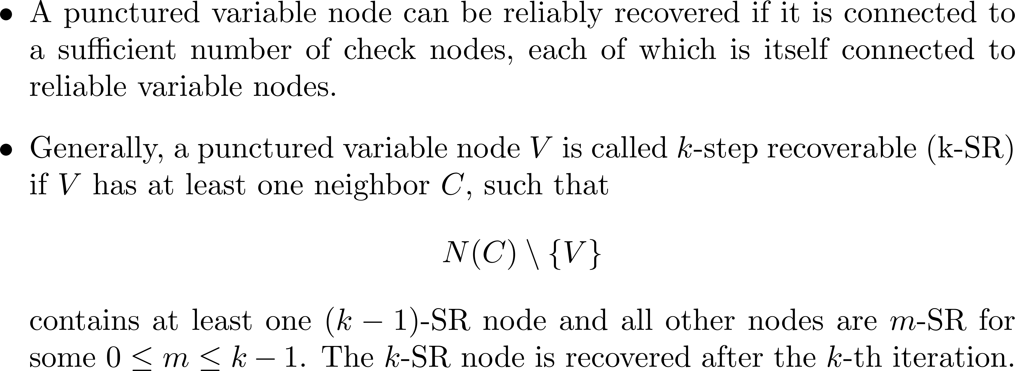

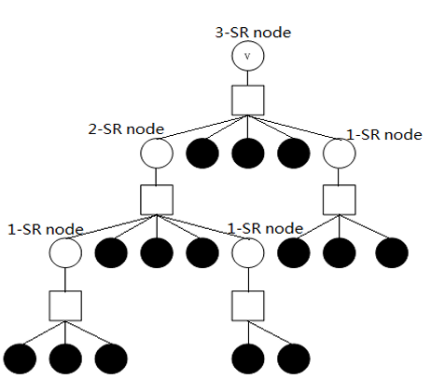
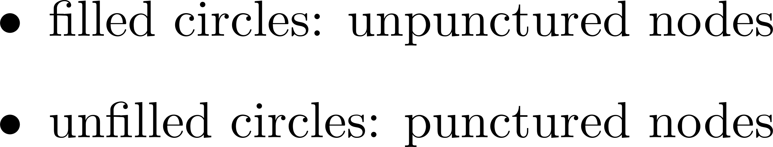
Puncture – k-SR

Slide 19
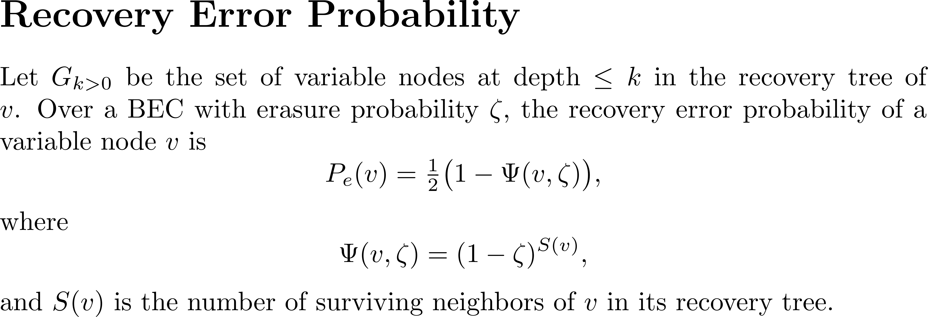


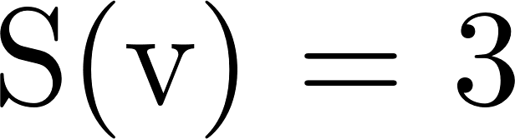
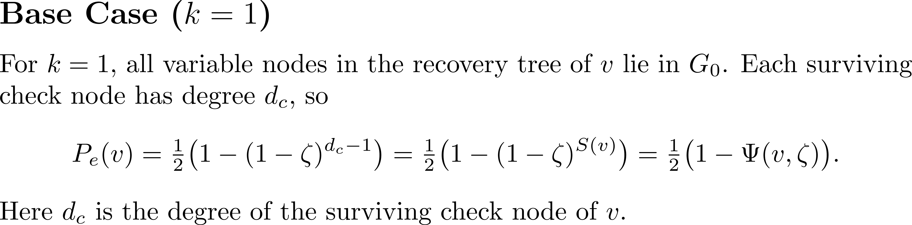
Puncture – k-SR

Slide 20
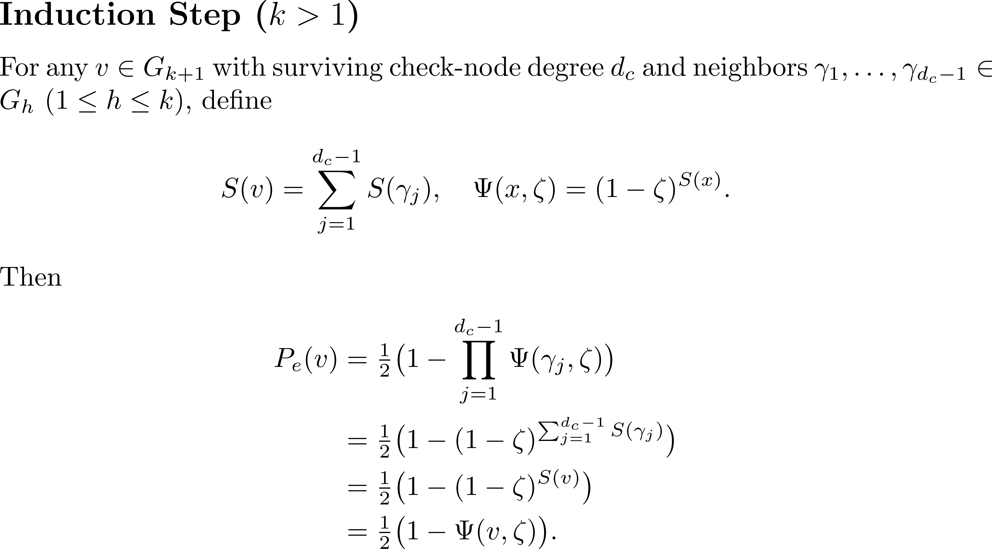
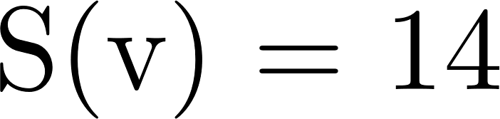
Puncture – k-SR

Slide 21
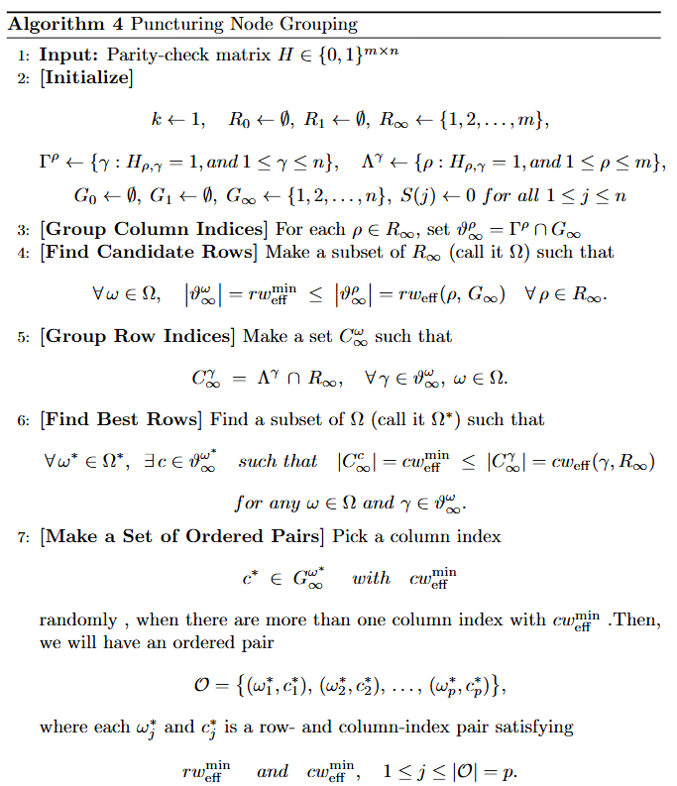
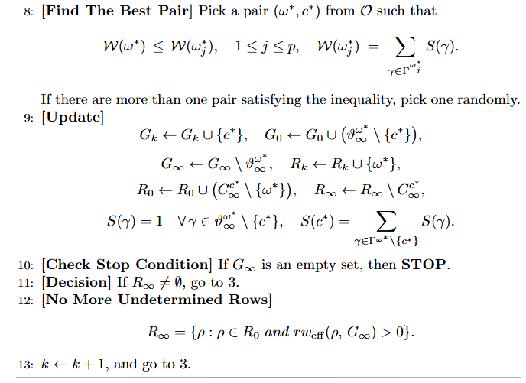
Puncture – k-SR Algorithm[4]
Notes:
1-找可以選的row(CN)
2-找出row degree 最小的
3-把cn底下的vn degree
3-

Slide 22
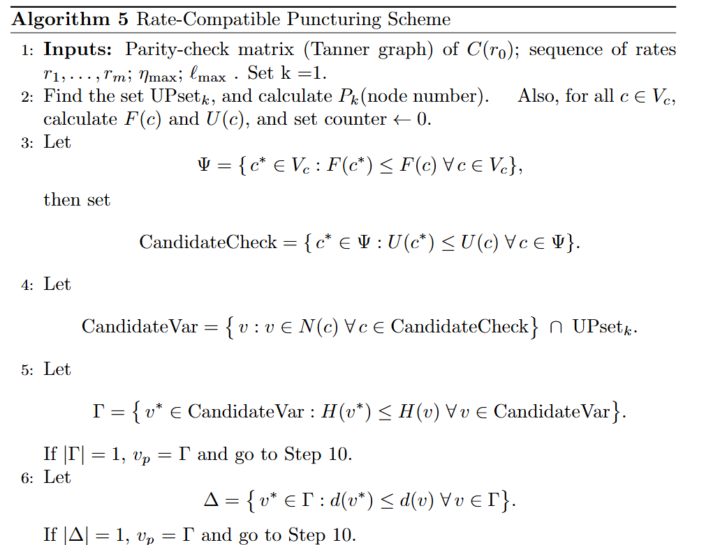
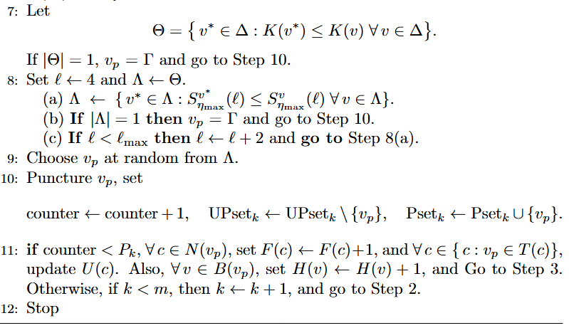
Puncture – RC Scheme Algorithm[3]

Slide 23
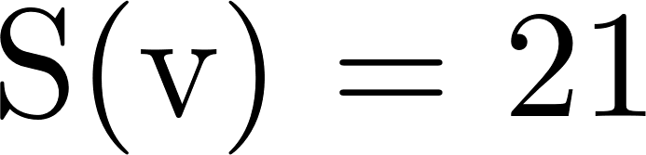
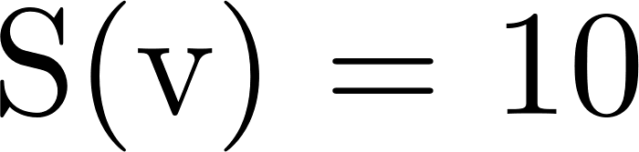
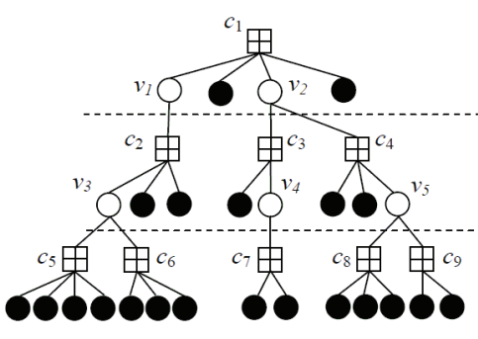
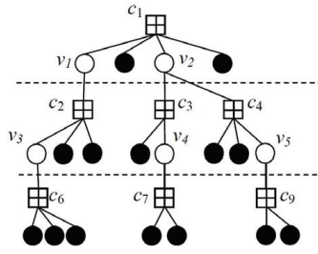
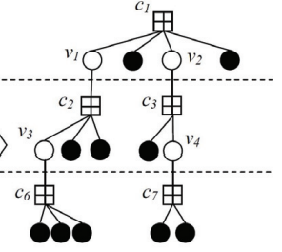

Puncture – RC Scheme Algorithm

Slide 24
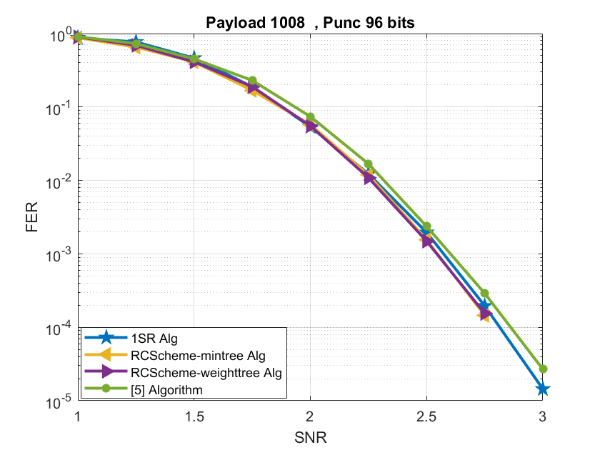
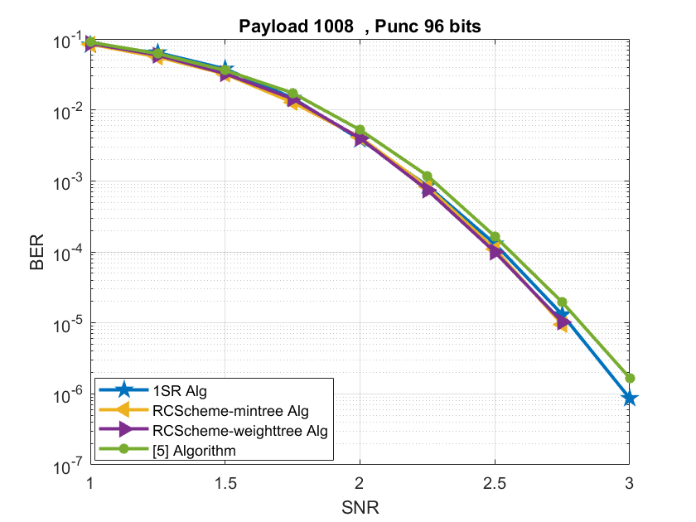
Puncture – simulation

Slide 25
Outline

Slide 26

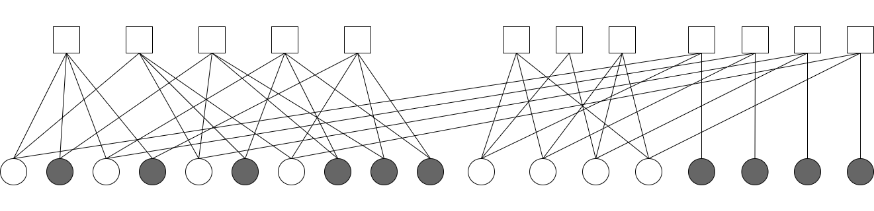
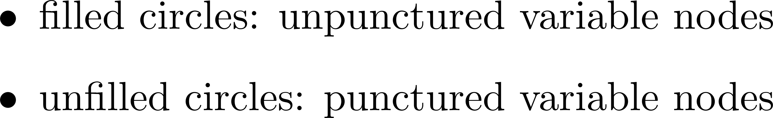
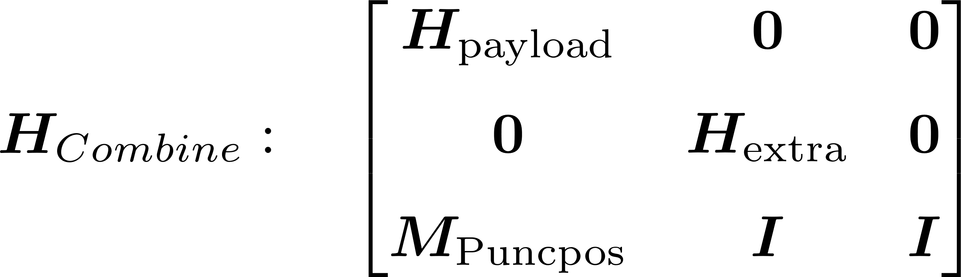
Origin Structure
P2
P4
P6
P8
P9
P10
P1^E1
P3^E2
P5^E3
P7^E3

Slide 27
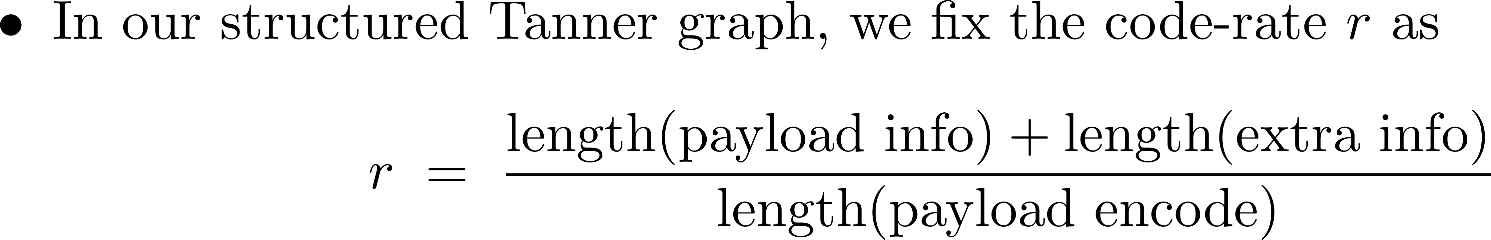
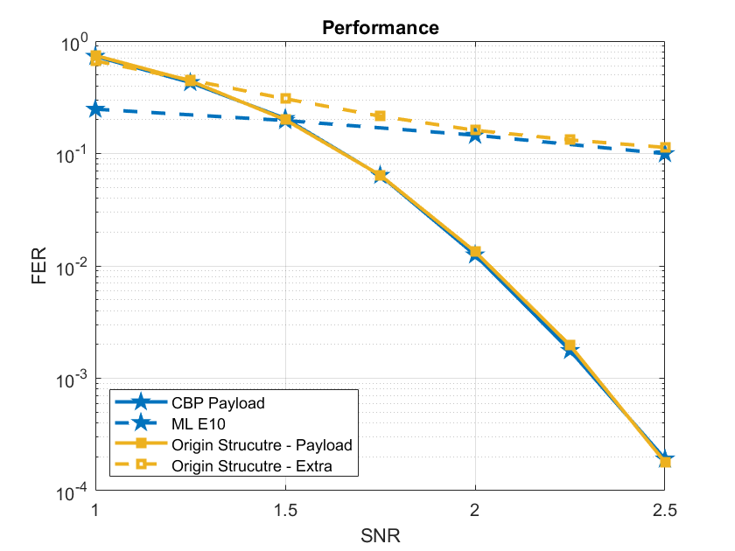
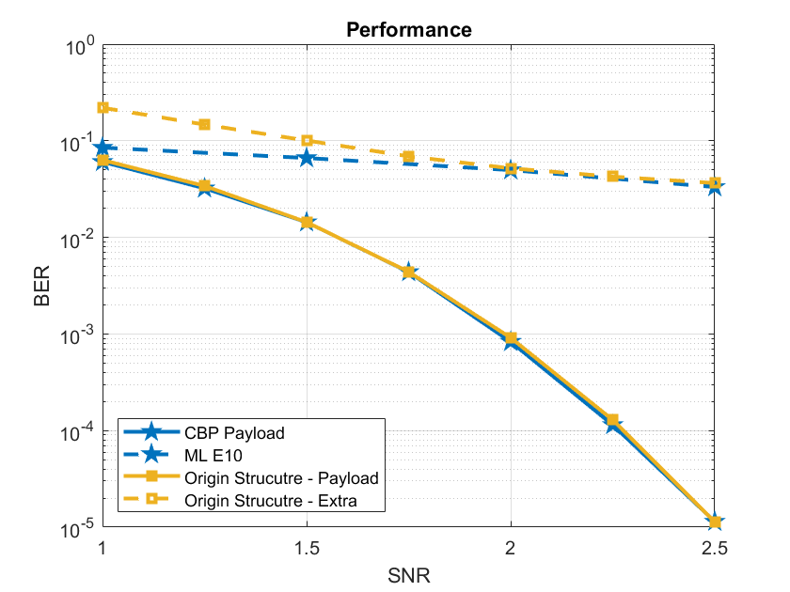
Origin Structure – Code-Rate Fix

Slide 28
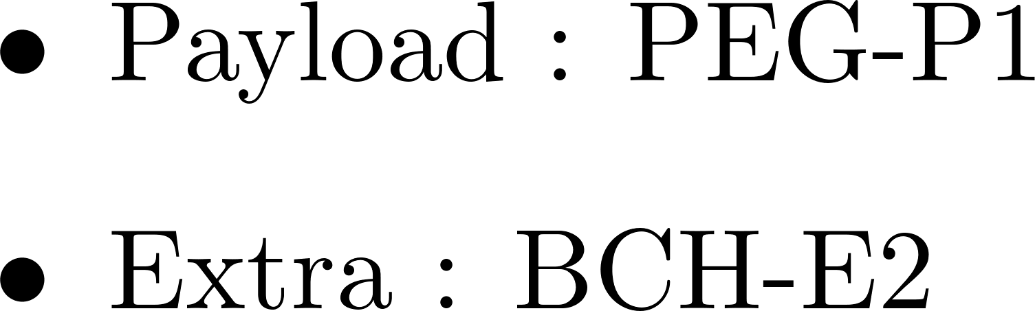
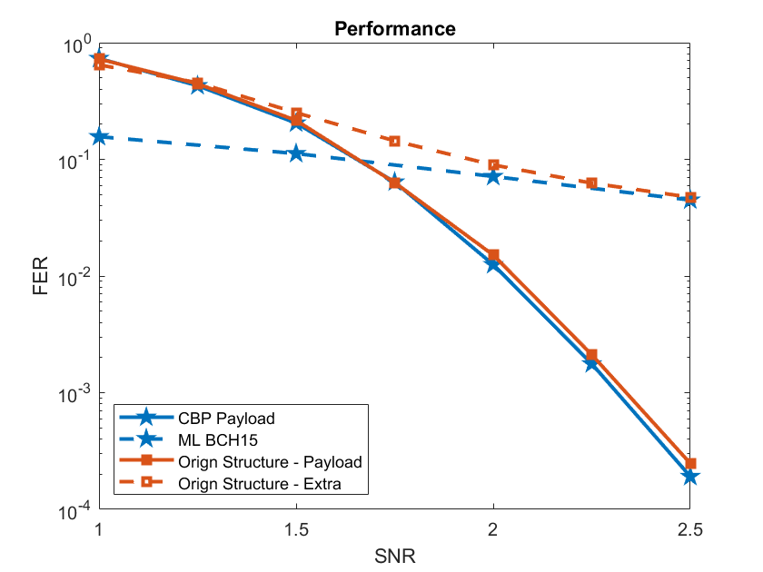

Origin Structure – Simulation

Slide 29

Origin Structure – Observation

Slide 30
Outline

Slide 31



Dual-Diagonal Structure
P2
P4
P6
P8
P9
P10
P1^E1
P3^2^P1^E1
P3^E2^P1^E1^P5^E3
P3 ^ E2 ^ P1 ^ E1 ^ P5 ^ E3 ^ P7 ^ E4

Slide 32


Dual-Diagonal Structure – Simulation

Slide 33


Dual-Diagonal Structure – Simulation

Slide 34

Dual-Diagonal Structure – Observation

Slide 35
Outline

Slide 36

Multi-info Structure
P2
P4
P6
P8
P9
P10
P1^E1^P2
P3^E2^P4
P5^E3^P6
P7 ^ E4 ^ P8

Slide 37


Multi-info Structure – Simulation

Slide 38


Multi-info Structure – Simulation

Slide 39
Outline

Slide 40


Partial-Extra Structure
P2
P4
P6
P8
P9
P10
E3
E4
P1^E1
P3^E2

Slide 41


Partial-Extra Structure – Simulation

Slide 42


Partial-Extra Structure – Simulation
Notes:
In the current architecture, payload and extra bits are almost entirely separated, so the performance gains are limited.

Slide 43

Partial-Extra Structure – Observation

Slide 44
Outline

Slide 45



Enhanced Structure

Slide 46


Enhanced Structure
P2
P4
P5
P6
P8
P10
E1^P1
E2^P3
E1^P9^P10
E2^P7^P8

Slide 47


Enhanced Structure – Simulation

Slide 48


Enhanced Structure – Simulation

Slide 49

Enhanced Structure – Observation

Slide 50
Outline

Slide 51



Partial-Extra & Enhanced Structure

Slide 52


Partial-Extra & Enhanced Structure – Simulation

Slide 53


Partial-Extra & Enhanced Structure – Simulation

Slide 54

Partial-Extra & Enhanced Structure– Observation

Slide 55
Outline

Slide 56

Reference

Slide 57
Reference

